Slide 1
Towards a gender-senstive RBM system
ESCWA Experts meeting Gender and Statistics
9-10 May 2016
Notes:
Title slide English/Arabic

Slide 2
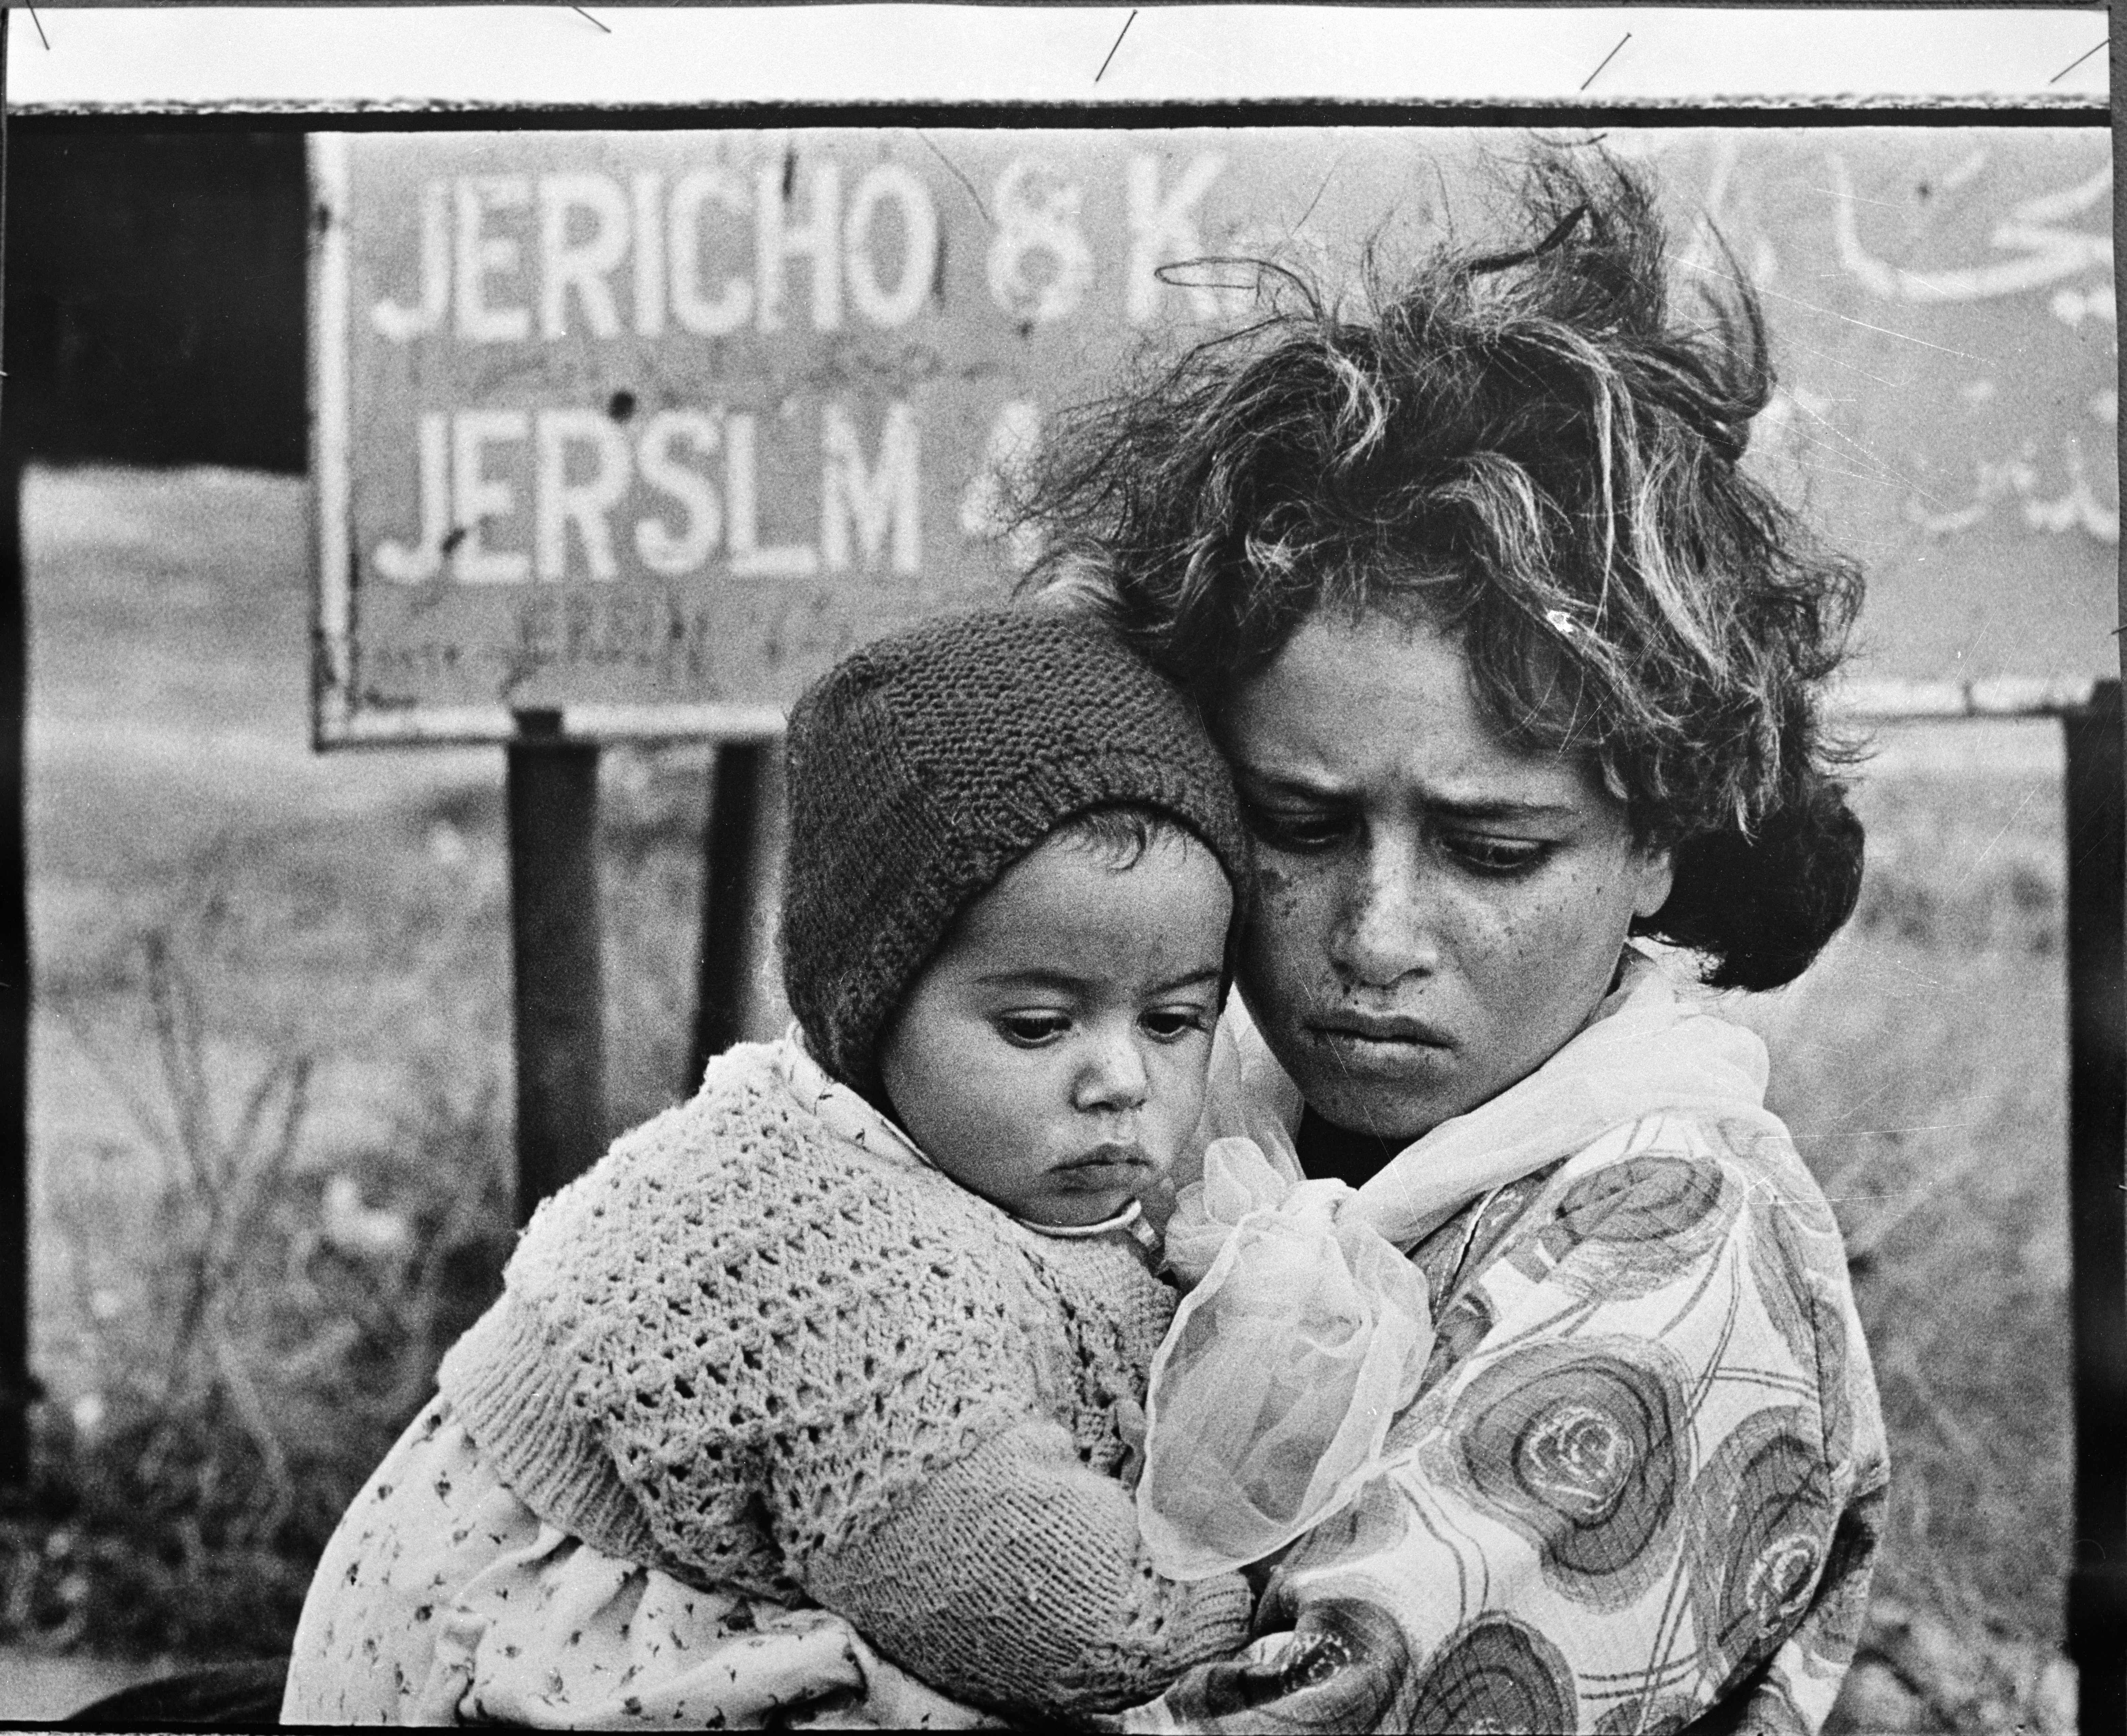
UNRWA
UNRWA is a United Nations agency established by the General Assembly in 1949 and is mandated to provide assistance and protection to a population of some 5 million registered Palestine refugees. Its mission is to help Palestine refugees in Jordan, Lebanon, Syria, West Bank and the Gaza Strip to achieve their full potential in human development, pending a just solution to their plight. UNRWA’s services encompass education, health care, relief and social services, camp infrastructure and improvement, microfinance and emergency assistance

Slide 3
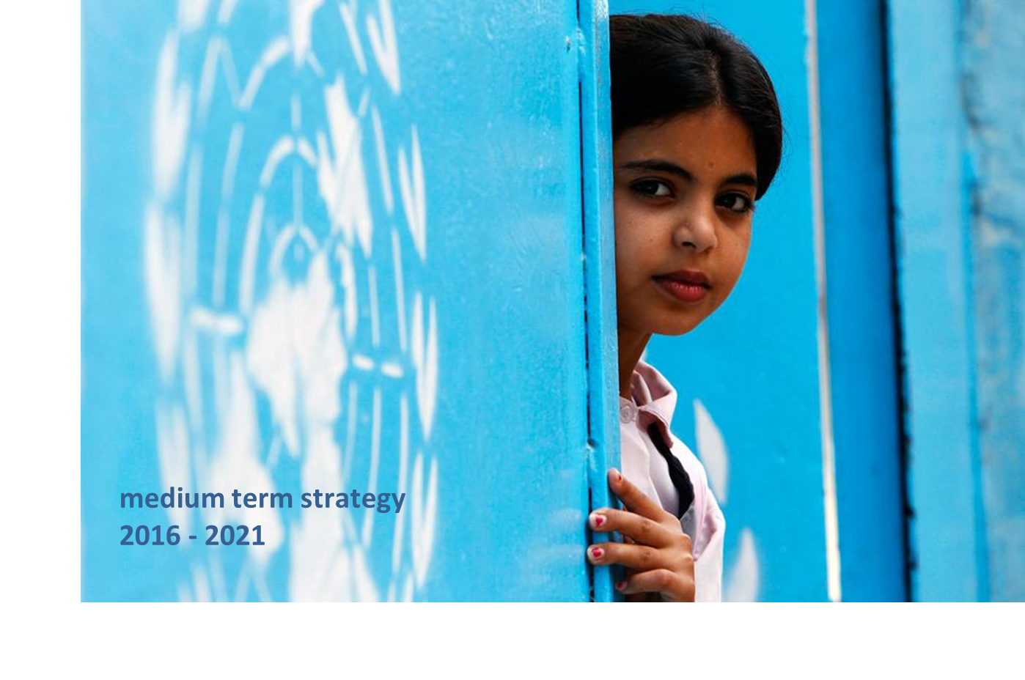
UNRWA MTS 2016-2021
UNRWA MTS puts gender at the heart of the analysis of the needs of Palestine Refugees: sex, residence, and socio-economic status are the variables in the analytical framework for vulnerabilities.
UNRWA embeds gender equality across all dimensions of the MTS Strategic Outcomes and in its management and operational objectives. Key indicators and targets are disaggregated by sex, thereby ensuring that gender receives specific attention at all stages of the programme cycle

Slide 4
UNRWA Common Monitoring Matrix
UNRWA uses more than 200 indicators (at the outcome and output levels) 80 are sex-disaggregated. They include main strategic areas in the programmes or the areas where a gender gap is already identified.
UNRWA sex disaggregated data allows to look into parity in access to services
Examples:
Number of students participated in at least one recreational and extracurricular activity (disaggregated by sex and disability) or
Percentage of registered persons affected by an emergency receiving humanitarian assistance (food, cash, job creation, NFIs) (disaggregation by sex, age and disability)
UNRWA disaggregated indicators looks into quality of access:
Examples:
Cumulative drop-out rate (elementary) boys and girls
Gap in student performance levels in MLA testing for boys and girls

Slide 5
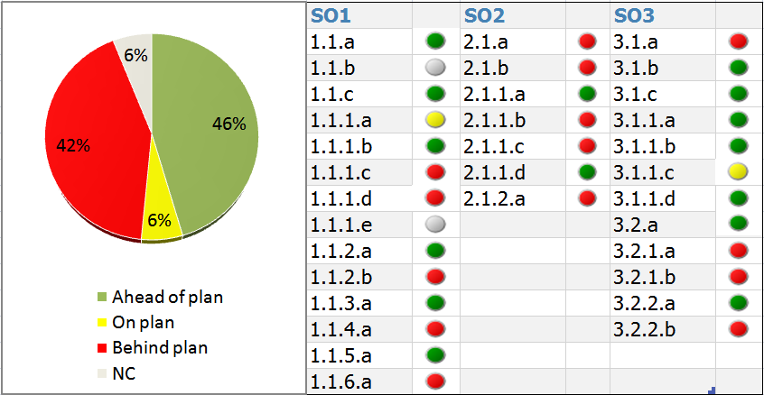
UNRWA Results Review and Reporting
Using a traffic light system UNRWA monitors results quarterly and has a an agency wide results review headed by the Deputy Commissioner General once a year.
Gender analysis is part of the discussion in the results review with guidelines on how gender should be taken into account in the analysis process during the review.
The use of sex-disaggregated data and specific guidance on the use of the gender analysis during the process helped identifying evidence based gaps:
Differences in the drop out between boys and girls
The number of men and women accessing UNRWA health centres.

Slide 6
Way forward
Gender sensitive reporting: reflecting on terminology used in indicators and reporting to make sure the terminology is gender sensitive;
Consolidate with analysis and studies once gaps are identified through sex-disaggregated data;
Re-input into strategic planning for the correcting measures.

Slide 7
Thank you

