Slide 1
Technical Design Issues in Constructing Migration Event Histories
Professor Tilman Brück
ISDC – International Security and Development Center
tilman.brueck@isd-center.org
www.isd-center.org
Workshop on “Civil Registration in Refugee Settings:
Advancing Assessment of CRVS in Unsettled Environments”
19-20 December 2016, Beirut

Slide 2
Disclaimers
CRVS is typically a government activity
I am an academic researcher
Key issues in CRVS focus on statistics
I am a development economist
CRVS focuses on administrative data
My expertise is in collecting and analyzing survey data
Most CRVS take place in countries at peace
My research focuses on conflict and fragile states
→ Outside-in perspective

Slide 3
Overview
Conceptual issues
Case studies
Angola
Kyrgyzstan
Syria

Slide 4
1: Conceptual Issues

Slide 5
Peace
birth
death
Challenges
statistical capacity
weak base data
complex regulations
undocumented citizens

Slide 6
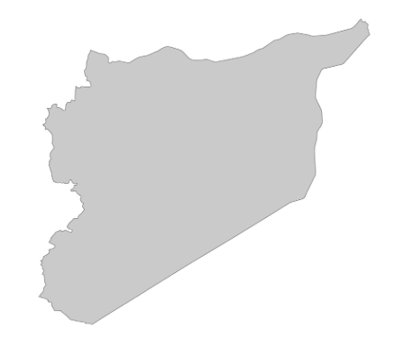
Migration
Syria
Lebanon
Additional challenges
availability and validity of foreign documents
illegal migration

Slide 7
War
birth
war
death
Additional challenges
destruction of capacity and of records
multiplicity of actors in humanitarian setting
scale of displacement
security of access
political agendas even more constraining
what are “vital statistics” for war-affected people?

Slide 8
War + Migration
birth in Syria
war
death in Lebanon
Additional challenges
paucity of complementary data
fluidity of household boundaries and household dispersion
strong behavioral responses to war and displacement

Slide 9
Objective of CRVS @ War
Recording
identifying residents and citizens
basic demographics
Organizing
planning eligibility and needs
Analyzing
understanding trends and causality
understanding key “transitions”
Discussion
overlapping concepts
fluid boundaries between CRVS and surveys
learn from household rosters in survey work
clarify objectives of CRVS before considering validation strategy

Slide 10
Levels of Aggregation
Individual level
recording: vital event, e.g. own birth
organizing: verification for government services, eg health care
analyzing: relationships between events and outcomes per person
Household level
recording: someone else’s vital event, eg birth of child
organizing: verification for government services, eg housing
analyzing: relationships between events and outcomes, within HH
National level
recording: vital event within or across groups
organizing: e.g. spatial planning
analyzing: population dynamics (by group)

Slide 11
Requirements
Completeness
even for formal records: what do you want to record and why?
that is, what is an “event”?
e.g.: live birth, stillborn birth, miscarriage, abortion, pregnancy?
what about trauma, experience of violence, loss of home etc?
risk of omitted variable bias?
Quality
beyond accuracy: know your error
patterns and errors will vary widely across sub-groups
Timeliness
this makes sense in domestic peace-time
but also record events ex-post, from time spent abroad?
Relevance
check if CRVS is relevant for the context

Slide 12
Which Events to Register?
In war, more than birth and death matters
location/jurisdiction is unclear
date of border crossing (what about repeated crossing?)
events concerning an individual vs. an individuals family
family vs. household (role of guardian, unaccompanied minors etc)
legality of status (who determines this?)

Slide 13
Who to Register?
Also look at host population
war in the region and being a host community has implications
for capacity to collect data
for political discussions and priorities
for service delivery
Maybe re-define standard protocol for CRVS

Slide 14
2: Case Studies

Slide 15
2: Case Studies
Study of Ex-Combatants in Angola
collecting and analyzing sensitive survey data in an orphan post-war country
with Wolfgang Stojetz (ISDC)
work-in-progress
data collection based on: Brück, T. et. al. (2016): “Measuring Violent Conflict in Micro-Level Surveys: Current Practices and Methodological Challenges”. World Bank Research Observer, 31(1): 29-58.

Slide 16
The Project
Study focus
participation of Angolan demobilized soldiers in their local community, economy, and family in the long run
Overall hypothesis
military service and exposure to war shape post-war behavior in economy, society and family
Relevance for our discussion
highlight heterogeneity in outcomes rooted in war exposure
indicate feasibility of enumerating war experiences
gain analytic strength from multi-disciplinary cooperation
stress importance of involving multiple stakeholders

Slide 17
The Survey
Fieldwork
Huambo province, Angola
760 veterans and partners from 34 clusters
complementary ethnographic study (Spall 2015)
Interviews and data
from veteran: pre-service, service and post-service (including wartime violence, e.g. sexual abuse)
from spouse: family and relationship outcomes (including domestic violence)
from couples: household outcomes

Slide 18
Challenge: Sensitive Topics
Respondents’ perspective: intimate and traumatic experiences
incentives to under-report e.g. social pressures, fears of retaliation or legal sanctions
incentives to over-report e.g. hopes of monetary benefits or health treatments
Government perspective
ex-combatants a ”high-risk group”
inefficient post-war assistance to ex-combatants

Slide 19
Strategies: Sensitive Topic
Engage with relevant/all authorities
for consent and support
Multi-disciplinary survey instruments
psychology module on traumatic experiences and mental health
ethnographic companion study (Spall 2015)
Select interviewers carefully
align language, ethnic group, social group (no ‘outsiders’)
Questionnaires
pre-test, pre-test, pre-test!
Interviewers
train, train, train! (key: atmosphere, trust)
Interviews
practice, practice, practice! (key: privacy)

Slide 20
Challenge: Capacity
Post-war setting
formal institutions are weak
informal institutions are strong and diffuse
existing government data likely not reliable/biased
’Orphan’ setting (JL Arcand)
few NGOs
few projects
few existing findings

Slide 21
Strategies: Capacity
Local partners
NGO
Local networks/visits
Engage with authorities
at all levels
Try to get hands on any secondary data available
e.g. ongoing census (design)
Build population lists at the cluster level (design)

Slide 22
Summary of Data Collection
Household survey
fieldwork: Jun-Aug 2012, Mar-May 2013, Aug 2013-Jan 2014
population: ex-combatants in Huambo province
stratification: 2/3 MPLA, 1/3 UNITA; 60% rural, 40% urban
interviews: household, veteran, spouse
questionnaires: electronic (tablets, ODK)
data storage: electronic (online, ODK)
Interviews and data
from veteran: pre-service, service and post-service/-war
from spouse: family and relationship outcomes
from couple: household outcomes

Slide 23
War-time Violence Exposure
Did veteran experience situations where... | Mean | SD | Min | Max
...fellow soldiers lost their lives? | 0.49 | 0.500 | 0 | 1
...enemies lost their lives? | 0.44 | 0.497 | 0 | 1
...civilians lost their lives? | 0.41 | 0.491 | 0 | 1
...civilians were attacked (no massacre)? | 0.45 | 0.498 | 0 | 1
...civilians were killed (massacre)? | 0.39 | 0.488 | 0 | 1
...civilian woman was sexually abused? | 0.22 | 0.414 | 0 | 1
Note: 0=No, 1=Yes, N=759

Slide 24
2: Case Studies
Life in Kyrgyzstan Study
with Damir Esenaliev (ISDC and SIPRI) and many other colleagues
Brück, T., D. Esenaliev, A. Kroeger, A. Kudebayeva, B. Mirkasimov & S. Steiner (2014): “Household Survey Data for Research on Well-Being and Behavior in Central Asia”. Journal of Comparative Economics, 42 (3): 819-35.
www.lifeinkyrgyzstan.org

Slide 25
Life in Kyrgyzstan Study
Tracking 8.160 individuals in 3.000 households in 120 communities
Yielding over 30 million data points so far
Stratified 2-stage random sampling from 2009 census
Representative: national, rural/urban, North/South
Data collection: around October–December
So far, 4 waves from 2010, 2011, 2012 and 2013
Currently, we are collecting wave 5
Data and questionnaires are available online
Research-led, open-access, independent study

Slide 26
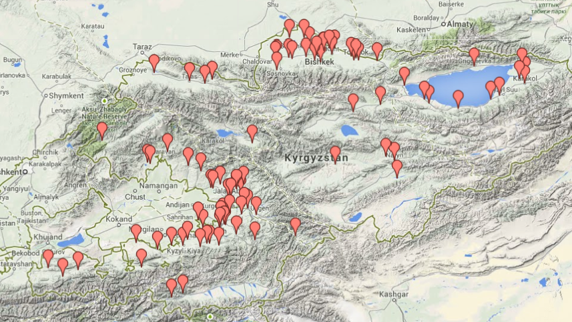
National Coverage

Slide 27
LiK is a Multi-Topic Survey
Farming and agricultural markets
Gender and intra-household bargaining
Assets, income, remittances and expenditure
Employment, entrepreneur-ship and migration
Demographics, education and child health
Public service delivery
Shocks, fears and security perceptions
Social capital, networks and subjective well-being
LiK
➔Huge benefits from connecting these themes!

Slide 28
Questionnaires
Individuals
family and household
subjective well-being
education and health
labor market
movements
social life
child anthropometrics
worries
security and violence
Households
household composition
child education and health
housing and assets
agricultural markets
consumption and expenditures
income
migration
shocks

Slide 29
6
Conflict and Displacement
Brück, Hennicke, Kröger and Vothknecht: work in progress using LiK 2010

Slide 30
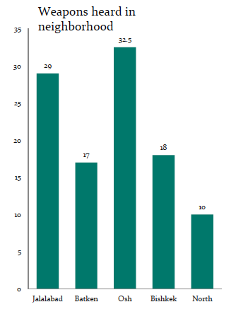
3
Indicators of Fragility
Brück, Hennicke, Kröger and Vothknecht: work in progress using LiK 2010

Slide 31
Impact of Conflict
Aladysheva and Brück: work in progress using LiK 2010

Slide 32
Implications
We regularly track for exposure to insecurity and fragility
This questions are less intrusive in the field than feared by many ex ante
Combining various topics is key for analysis
Conflict and fragility impact on people significantly
Hence we build up understanding of key life events over time

Slide 33
2: Case Studies
‘Crowd-seeding’ Conflict and Peace Data in Syria
with Ghassan Baliki (ISDC)
work-in-progress

Slide 34
Design
Trained reporters in 11 geographic areas in Syria
They report:
detailed information on violence, peace, kidnapping, and looting
information at the local level, mainly within their geographic proximity
information which they either observed personally or through their key local network informants
which is directly coded into a database (real-time) via a secure platform

Slide 35
Codebook and Platform
Codebook
developed in line with existing conflict event databases (with some minor adjustments)
It includes detailed description of the information and definitions of the main events and their attribute data
Online platform
entry sheets are based on the structure of the codebook
access and submission of information (events) is anonymous and highly secure
data is immediately stored and updated into a shared database, and readily accessible for basic analysis

Slide 36
Generic Events
Geo-location of an event
separately divided between large cities and other geo-areas
constitutes of 6 precision levels (down to city neighborhood level)
reporters click an embedded map and specify the precision level (coordinates are generated automatically)
Date of submission and date of event and temporal precision (exact date, within 2 days, etc)
Sources of information
trust and reliability for second degree observations from their local networks
Sensitivity of publishing certain incidents to reduce risk
Open list of actors to choose from and to add to

Slide 37
Example of Database

Slide 38
Violent Events
Forms of Violence
violence between armed actors (battles)
indiscriminate violence against civilians
one-sided violence (with no clear target)
Tools of Violence
Aerial and Anti-aerial; Ground-to-ground (Heavy); Small and medium firearms; Stationary explosives; Suicide bombings; etc
Outcomes of Violence
death of armed actors and/or civilians per events
injury
destruction of dwellings or Infrastructure (very detailed)
displacement as a result of a violent event
territory gain or loss (with it spatial coordinates and actors involved)

Slide 39
Peace Events
Mainly around agreements at the local level between local actors
Forms of peace events include
invitations, talks, reaching agreements
rejections of talks, violations, and breaking-off agreements
Types of agreements are divided into 2x2 matrix
permanent or temporary
involves suspension of violent or other non-violent related issues (aid access)

Slide 40
Example of Database

Slide 41
Example of Analysis

Slide 42
Comparison of Methods
 | Crowd-Seeding | Crowd-Sourcing | Traditional
Non-retrospective | ✔ | ✔
Elimination of media bias | ✔ | ✔
Elimination of reporting fatigue | ✔
More detailed and micro-level | ✔ | ✔ | ✔
More precise coordinates | ✔
Codebook-oriented | ✔ |  | ✔
Less costly |  | ✔
Less risky |  | ✔ | ✔

Slide 43
Implication
Tools like our crowd-seeding database of conflict and peace events may be critical for the validation of official records and survey data

Slide 44
Conclusions
Validate information across data sources
Current project design asks if system works and aims to strengthen system
But also ask what we do not know and what would CRVS need to do to support critical learning (i.e. what are knowledge gaps)

