Slide 1
Jon Pedersen:
Validation of CRVS through surveys
Some considerations
What are the critical design and implementation issues to be considered for
carrying out a validation study in Jordan – given that part of the refugee
population lives outside of camps and that there are useful data from the 2015
population census?
Can particular use be made of the 2015 Jordanian census
and available UNHCR registration data? If so, what coverage limitations of the
Jordanian Census and the UNHCR Registration data need to be considered?
◦ What are the critical design and implementation issues to be considered for a
validation survey in Lebanon – given that the last population census was in
1932?

Slide 2
Main issues in a validation survey
What should be estimated and with what estimators?
How can the target population be reached?

Slide 3
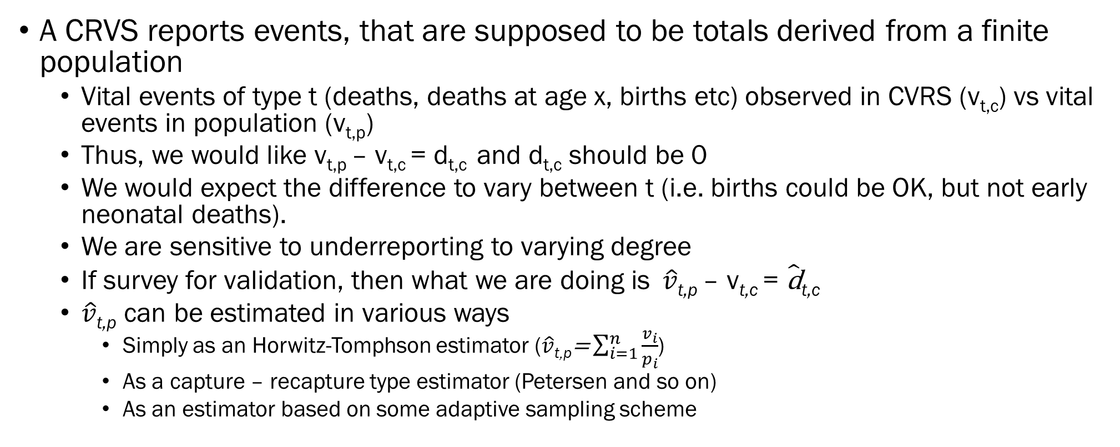
Possible estimators
A CRVS reports events, that are supposed to be totals derived from a finite population
  Vital events of type t (deaths, deaths at age x, births etc) observed in CVRS (v_{t,c}) vs vital events in population (v_{t,p})
  Thus, we would like v_{t,p} – v_{t,c} = d_{t,c} and d_{t,c} should be 0
  We would expect the difference to vary between t (i.e. births could be OK, but not early neonatal deaths).
  We are sensitive to underreporting to varying degree
  If survey for validation, then what we are doing is$\hat{v}\text{t}\text{,}\text{p} \text{– }\text{v}\text{t}\text{,}\text{c} \text{= }\hat{\text{d}}\text{t}\text{,}\text{c}$
  $\hat{v}\text{t}\text{,}\text{p}$ can be estimated in various ways
    Simply as an Horwitz-Tomphson estimator ($\hat{v}\text{t}\text{,}\text{p}\text{=}\sum_{i=1}^{n}{\frac{v_{i}}{p_{i}}}$)
    As a capture – recapture type estimator (Petersen and so on)
    As an estimator based on some adaptive sampling scheme

Slide 4
Short aside on capture recapture
Typical CRVS – survey table
(Large) survey carried out after CRVS enumeration. The two are then matched.
In demography constructed differently than the typical capture recapture, but actually the same
corresponds to (i.e. Petersen estimator)
Assumes a lot:
  The population is closed
    There are no immigration or emigration, no deaths or births
  All have the same chance of being observed in the first sample
  Marking individuals does not affect their chance of being reobserved
  Individuals are reliably identified as having been observed before or not
  But possible to relax assumptions with more complex estimators (rather dramatic effects)
 | In CRVS | Not in CRVS | Total
In survey | N₁ | D | N₁+D
Not in survey | C | N₂ | C+N₂
Total | N₁+C | D+N₂ | Total
 | In CRVS | Not in CRVS | Total
In survey | R |  | C
Not in PES
Total | M |  | Total
Sometimes more complex modelling of each cell
Notes:
See:

Slide 5
Possible estimators: Derived
Rate or ratios: Alternative to estimators of events
Benefit:
  Intutively tells if the data makes sense
Drawbacks
  Even if rates makes sense, there may be under-reporting of events
  May be difficult to interpret
  Survey derived rates are typically calculated differently than CRVS-derived ones (especially ₁q₀ and ₅q_{0,} Not a problem for births)

Slide 6
Possible estimators: secondary derived
Calculation of diagnostic estimators from the rates (e.g. Proportion early neonatal of neonatal mortality)
Benefit: May be quite revealing
Drawbacks:
  Standards may be changing (and are only partly known)
  Variance

Slide 7
Different situations for validation surveys
 | Far from complete CRVS | Nearly complete CRVS
Target population is «elusive» (H2R) | Main challenge lies in surveying elusive population | Both elusive and sample size challenge
Target population is standard | Degree of non-completeness relatively easy to estimate | Determining completeness requires large samples

Slide 8
Coverage of CVRS
Vital events of type t (births, deaths, deaths at age x)observed in CVRS (v_{t,c}) vs vital events in population (v_{t,p})
Thus, we would like v_{t,p} – v_{t,c} = d_{t,c} and d_{t,c} should be 0
We would expect the difference to vary between t.
Alternatively we may express the differences as differences between rates or ratios, but:
  since CRVS rates differently constructed from survey based ones, difficult to do when CRVS is close to completeness (because difference in calculation method matters
  but simpler to focus on totals, i.e. the number of events themselves rather than estimators derived from them)
Problem is estimating vital events in the population from a survey with
  Sufficent precision (sampling and measurement uncertainty)
  Lack of bias

Slide 9
Reaching the population: the examples of Jordan and Lebanon
Jordan
  «Easy» part and difficult part: Camps, vs displaced outside camps
  2015 census
    Surprising population size
    Good delineation of enumeration area cartography
    DoS traditionally not so good on actual listing within EAs. unclear why large number of migrants reported in census, as they are usually not covered well in surveys
    Traditional weak spot is work sites.
    For study of Iraqis in Jordan 2004 census was less informative in 2008 than envisaged, because of substantial movements of refugees
    Definition issue: who are refugees

Slide 10
Reaching the population: the examples of Jordan and Lebanon
No census since 1932
CAS has prepared delination of EAs based on satelitte imagery, but getting old.
Several polling firms have prepared their own (relatively) smalll area population estimates
Overall proportion of migrants high (> 10%)
Some geographic clustering of migrants
Likely migration
Some areas have security challenges
Definition issue: who are refugees

Slide 11
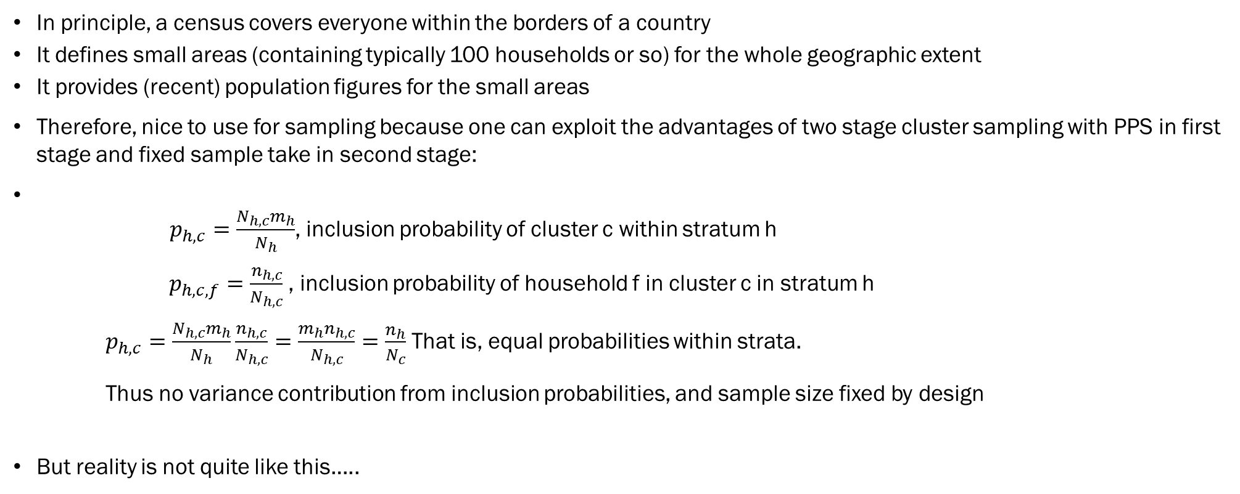
Use of a census for sampling 101 a
In principle, a census covers everyone within the borders of a country
It defines small areas (containing typically 100 households or so) for the whole geographic extent
It provides (recent) population figures for the small areas
Therefore, nice to use for sampling because one can exploit the advantages of two stage cluster sampling with PPS in first stage and fixed sample take in second stage:
$p_{h,c}=\frac{N_{h,c}m_{h}}{N_{h}}$, inclusion probability of cluster c within stratum h
$p_{h,c,f}=\frac{n_{h,c}}{N_{h,c}}$, inclusion probability of household f in cluster c in stratum h
$p_{h,c}=\frac{N_{h,c}m_{h}}{N_{h}}\frac{n_{h,c}}{N_{h,c}}=\frac{m_{h}n_{h,c}}{N_{h,c}}=\frac{n_{h}}{N_{c}}$That is, equal probabilities within strata.
Thus no variance contribution from inclusion probabilities, and sample size fixed by design
But reality is not quite like this…..

Slide 12
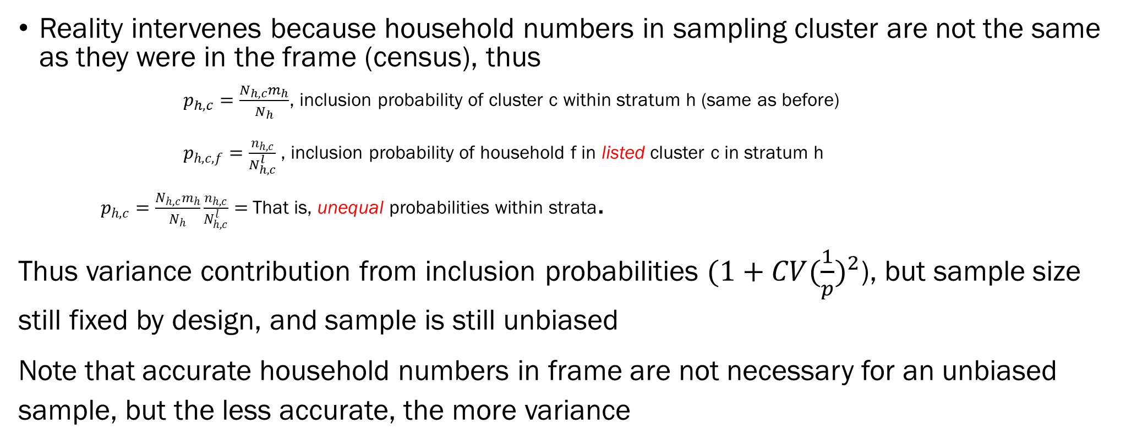
Use of a census for sampling 101 b
Reality intervenes because household numbers in sampling cluster are not the same as they were in the frame (census), thus
        $p_{h,c}=\frac{N_{h,c}m_{h}}{N_{h}}$, inclusion probability of cluster c within stratum h (same as before)
$p_{h,c,f}=\frac{n_{h,c}}{N_{h,c}^{l}}$, inclusion probability of household f in listed cluster c in stratum h
$p_{h,c}=\frac{N_{h,c}m_{h}}{N_{h}}\frac{n_{h,c}}{N_{h,c}^{l}}=$That is, unequal probabilities within strata.
Thus variance contribution from inclusion probabilities $(1+{CV(\frac{1}{p})}^{2}$), but sample size still fixed by design, and sample is still unbiased
Note that accurate household numbers in frame are not necessary for an unbiased sample, but the less accurate, the more variance

Slide 13
Use of census for sampling 101 c
Other aspects of reality are more important for lack of bias:
  If the delineation of enumeration areas exhausts all areas in the country, and there is a way to up-date the actual frame with enumeration areas that have become populated
  If there are procedures in place that ensures that everyone that actually resides in an enumeration area actually can be counted (i.e. how non-residental space is treated, informal housing etc)

Slide 14
Dealing with H2R («Elusivenes»)
Various methods
  Double sampling – screening
  Disproportinate allocation – not so good
  Adapative sampling
  Indirect sampling

Slide 15
Adaptive cluster sampling
Used for populations that are rare, but clustered
Some form of sample frame exists
Procedure
  Select an ordinary cluster sample
  If a cluster contains more than z target respondents, choose all neighbours of that cluster.
  Continue selecting neighbours until cluster contains less than z target respondents
For
  Easy /both procedure and estimation)
  Works well when clustered population assumption fulfilled
Against
  Very rare populations -> no respondents
  Not so rare populations -> all clusters selected

Slide 16
Actually: Jordan and Lebanon are not so different
Cartography
  Jordan has more accurate cartography, but CAS cartography in Lebanon not bad (but a bit old).
  Satellite images in Lebanon better for internal structure of EAs
Population counts
  Question remains about Jordan’s, probably not very good for migrants
  Lebanon: well.
  Migration likely to have messed up counts for population of interest. (note that we loose much of the benefit of our 101 description if we are interested in a sub group)

