Slide 1

Collecting Data at the Micro-Level:
Reflections and Recommendations from Projects in Fragile and Conflict-Affected Scenarios
Neil T. N. Ferguson
International Security and Development Center
Expert Group Meeting on Civil Registration in Refugee Settings
20 December 2016 – ESCWA – UN House, Beirut, Lebanon

Slide 2
Outline
Introduction: Why Collect Data at the Micro-Level
Case-studies:
  Behavioural games in Kenya
  Survey data on nutrition in Niger
  The ‘Fragility Module’
Lessons Learned and Conclusions

Slide 3
Introduction
Why measure at the micro-level?
  An example from our work on conflict and fragility:
  Historical focus on ‘states’ of conflict
    Early data sets (e.g. PRIO/UCDP): binary information on whether a country was at war or not in a given year
    Lack of fine-grained information and susceptibility to thresholds
  More recent focus on ‘extent’ of conflict
    ACLED – geo-coded event count data for Africa and Asia
    Ushahidi – crowd-sourced event counts
  These approaches enforce a critical assumption on researchers:
    Everyone in a given area experiences conflict in the same way
    Same logic can be used to understand array of other / related phenomena: e.g. exposure to fragility, displacement…

Slide 4
Introduction
How to measure conflict at the micro-level?
  Panel household surveys (Justino et al., 2013)
    Collects a range of socio-demographic data from representative group of individuals over time
    Augmented with ‘conflict module’ – questions on private experiences relating to conflict
      E.g. personal / familial victimisation; presence of armed groups; fear of violence
  Behavioural experiments (Bauer et al., 2013)
    Collects data on how individuals behave in a range of hypothetical scenarios
    Can ‘prime’ along ‘in-group’ and ‘out-group’ lines – e.g. testing the role of ethnicity in behaviour
    …or on exposure to conflict – e.g. does exposure to, or experience of, conflict lead to changes in behaviour?

Slide 5
Case Study 1:
Behavioural Games in Kenya
  Purpose:
    To understand if exposure (regional and personal) to electoral violence affects economic decision-making
    To understand if response to conflict different along in-group or out-group lines
  Results:
    Those exposed to conflict exhibit (surprisingly) different behaviour: expect better of others and reciprocate more
    No apparent differences across in-group or out-group partners

Slide 6
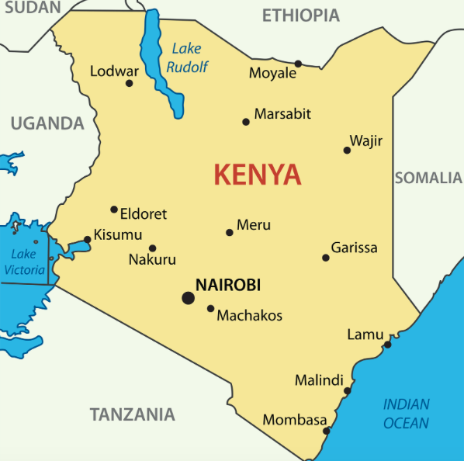
Case Study 1:
Approach:
  Three games played
  Elicited behaviour and
  expectations
  Survey conducted about
  experience of risky behav-
  iours
  Data collected in:
    Multi-ethnic regions in
    Nairobi
    Mono-ethnic areas near
    Kisumu

Slide 7
Case Study 1:
Approach:
  Data collected from 654
  individuals
    All men
    432 in Nairobi
    212 in Kisumu
  Data collected from two
  tribes:
    273 Kikuyu
    381 Luo

Slide 8
Case Study 1:
Reflections:
  Differing responses between those exposed and not exposed to conflict show importance of collecting behavioural data
  Private experience has an impact over and above aggregate (neighbourhood) experience
  Significant difficulties in collecting certain forms of data
    Few individuals admit engagement in risky behaviours
  Certain level of abstraction remains, although not just in our case

Slide 9
Case Study 2:
Nutrition in Niger:
  Purpose:
    To understand the effectiveness of WFP programmes in “non-ideal” type circumstances
    To understand presence of / extent of synergies between different programming modalities
  Outcomes:
    Research presently on-going
    Endline survey data collected

Slide 10
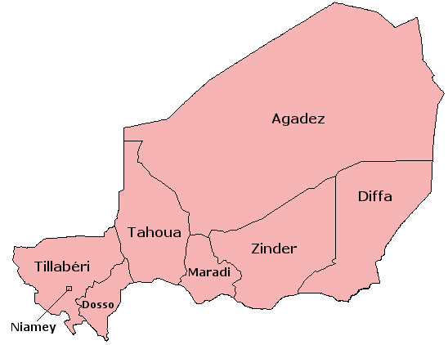
Case Study 2:
Approach:
  Two waves of survey data
    Wave 1: WFP Baseline
    (2014)
    Wave 2: Joint WFP-ISDC
    Endline (2016)
    Both waves collected by
    Niger national statistics
    agency (INS)

Slide 11
Case Study 2:
Approach:
  Wave 1:
    Random, stratified sample
    of ‘very poor’ households
    Representative at national
    level; and at agricultural
    zone level
      Although noted difficulty
      of ensuring representation
      in unstable / mobile pops
    Data from 5,921 HH in all
    regions of Niger

Slide 12
Case Study 2:
Approach:
  Wave 2:
    Attempted full resampling
    of baseline data
    Inclusion of retrospective
    questions on experience of
    shocks
    Expected attrition: c. 10%
    Actual attrition: c. 50%
    Why?
      Deteriorating security situat-
      ion in Diffa (no HH visited)
      Enumeration team attacked
      and robbed in Tillaberi
      …but attrition still problematic
      in the rest of the country

Slide 13
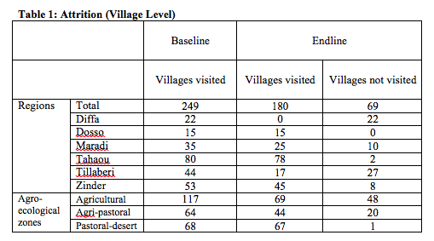
Case Study 2:

Slide 14
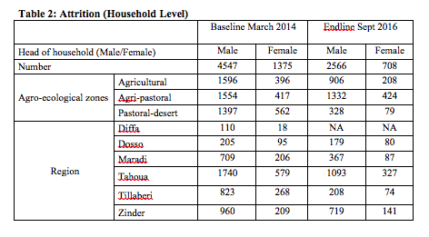
Case Study 2:

Slide 15
Case Study 2:
Reflections:
  Questions arise about certainty of representativeness of the first wave, given fluid, unstable population
  Panel data collection remains complicated in fluid security situations – tracking systems need to be in place from baseline, especially for those fleeing violence
  Security of enumeration teams operating in conflict-affected or fragile countries should never be taken for granted
  Despite large loss of data, sample remains usable at some levels - e.g. agro-pastoral regions – and useful for analysis but usefulness should never be assumed at the outset
  Particularly with major events and long but non-specific timelines, retrospective questions garner usable responses but must be carefully considered
  Significant data collected by project partners (WFP) that could be useful but has not been collated – a cautionary tale for future effort

Slide 16
Case Study 3:
The ‘Fragility Module’
  Purpose:
    To assess the notion that fragility can (or even should) be measured at the individual rather than national level
    To test how experience of fragility varies over sub-national regions, gender, or other classifications
  Results:
    We find significant variation in exposure to and experience of fragility across groups in Liberia
    We find a general reduction in individual experience of fragility in Liberia over time

Slide 17
Case Study 3:
Approach:
  Creation of operationalisable definition of ‘fragility’ that moves away from common state-centric approach
  Generation of a series of survey questions that measure individual exposure to a range of phenomena linked to this definition
  Creation of “off-the-shelf” fragility module, based on these questions, to be inserted in ongoing panel household surveys
    Data collection from two household surveys on-going:
      HORTINLEA Survey in rural Kenya
      Life in Kyrgyzstan Study Survey
    Use of sub-set of questions currently asked in Afro-Barometer

Slide 18
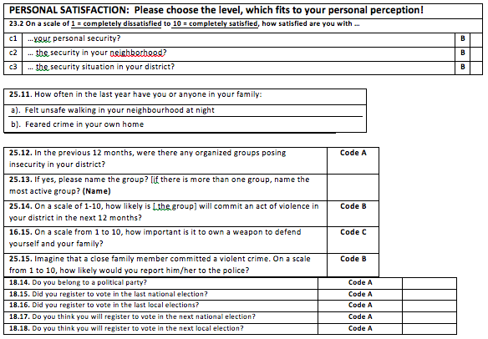
Case Study 3:

Slide 19
Case Study 3:
Reflections:
  Fragility is, in all likelihood, something that is experienced at the individual or household level and therefore requires data collected at this level
  Collecting such data appears to be possible, yet both of our sample countries are not currently considered “fragile” even if areas within them are
  Careful selection of our sample countries and surveys as ‘proof of concept’ – broadening this data collection effort is not a trivial matter
  Consequently, collecting data in “more fragile” countries may suffer some of the same issues as our efforts in Niger

Slide 20
Conclusions
Given the wide-array of research results derived from using micro-level data in FCS, the need for further work and further data is clear
Collecting said data, however, is not a trivial matter – FCS are highly fluid and complex scenarios and require data collection strategies to match
There are also very real dangers in collecting these data in FCS scenarios
Such data, however, is an invaluable research tool and the risks and benefits therefore must be weighed up

Slide 21
Lessons Learned
There is no single best fit method for data collection at the micro-level in FCS:
  Behavioural games provide only abstract links to the real world and real world conflicts
  Panel surveys, however, require complex (and expensive) strategies to ensure manageable attrition
  Both, however, offer significantly more insight than country-level and pan-national approaches
Collection of such data can be difficult in challenging environments:
  Sample attrition and physical danger are both real and present concerns, as our experiences have shown
  Security concerns must be weighed up before collection is undertaken but there may also be scope for novel approaches, such as crowd-seeding or crowd-sourcing
  Innovative follow-up strategies are also needed in situations where populations are highly mobile or where the risk of displacement is high
  Displacement is a major concern: not only does it cause attrition but because urgent need remains to understand what happens to displaced populations
Retrospective questioning appears to be possible but is not without its risks: increases in accuracy of desired information come with cost of decreased accuracy of recall
Collection of these data provides unprecedented opportunity to understand the causes of and impacts of conflict, fragility, displacement, etc.

Slide 22
  neil.ferguson@isd-center.org
  International Security and Development Center
  Friedrich Str. 246
  10969, Berlin
  Germany
  info@isd-center.org

