Slide 1

NORWEGIAN
REFUGEE COUNCIL
Assisting Refugees in Lebanon with Civil Status Registration
Beirut, 19 December 2016

Slide 2
Syrian Refugees in Lebanon
NORWEGIAN
REFUGEE COUNCIL
1,017,433 registered with UNHCR (Sept 2016)
Govt of Lebanon estimates: 1,5 mio
Scattered across some 4,000 informal tented settlements, and within host communities, ‘no-camp policy’
Growing portion of Syrian refugees without legal stay

Slide 3
NRC’s Information, Counseling and Legal Assistance program in Lebanon
NORWEGIAN
REFUGEE COUNCIL
established in 2012, country-wide assistance through community centers, legal clinics, mobile clinics/courts
Syrian refugees assisted on civil documentation issues in 2015-16:
info sessions – 279,737, counseling 29,226, legal representation – 6,345
main caseload: birth and marriage registration, but also death/divorce registration; housing, land and property; legal stay;

Slide 4
Highlights on Birth Registration Procedure
Importance – (1) evidence of relationship between baby and parents; (2) assists with obtaining Syrian ID for the baby when parents will voluntarily return to Syria; (3) helps to register the baby with UNHCR to access services; (4) reduces risk of statelessness.
The procedure consists of 3 main steps :
Obtaining the birth notification from the hospital or midwife.
Obtaining the birth certificate from the Mukhtar.
Registering the Birth certificate at the Personal Status Department ((a) Nofous and (b) the Foreigner’s Registry).
Steps 1, 2 and 3(a) should be completed within one year. After this time it will only be possible to register the birth through a costly/lengthy court procedure.

Slide 5
Highlights on Birth Registration Procedure
Steps 1 and 2 of the birth registration procedure, namely obtaining (1) the birth notification; and (2) the birth certificate, can be achieved in most cases.
Those who do not have legal entry and residency visa are advised not to approach foreigner’s registry for birth registration as they risk having their cases referred to General Security.

Slide 6
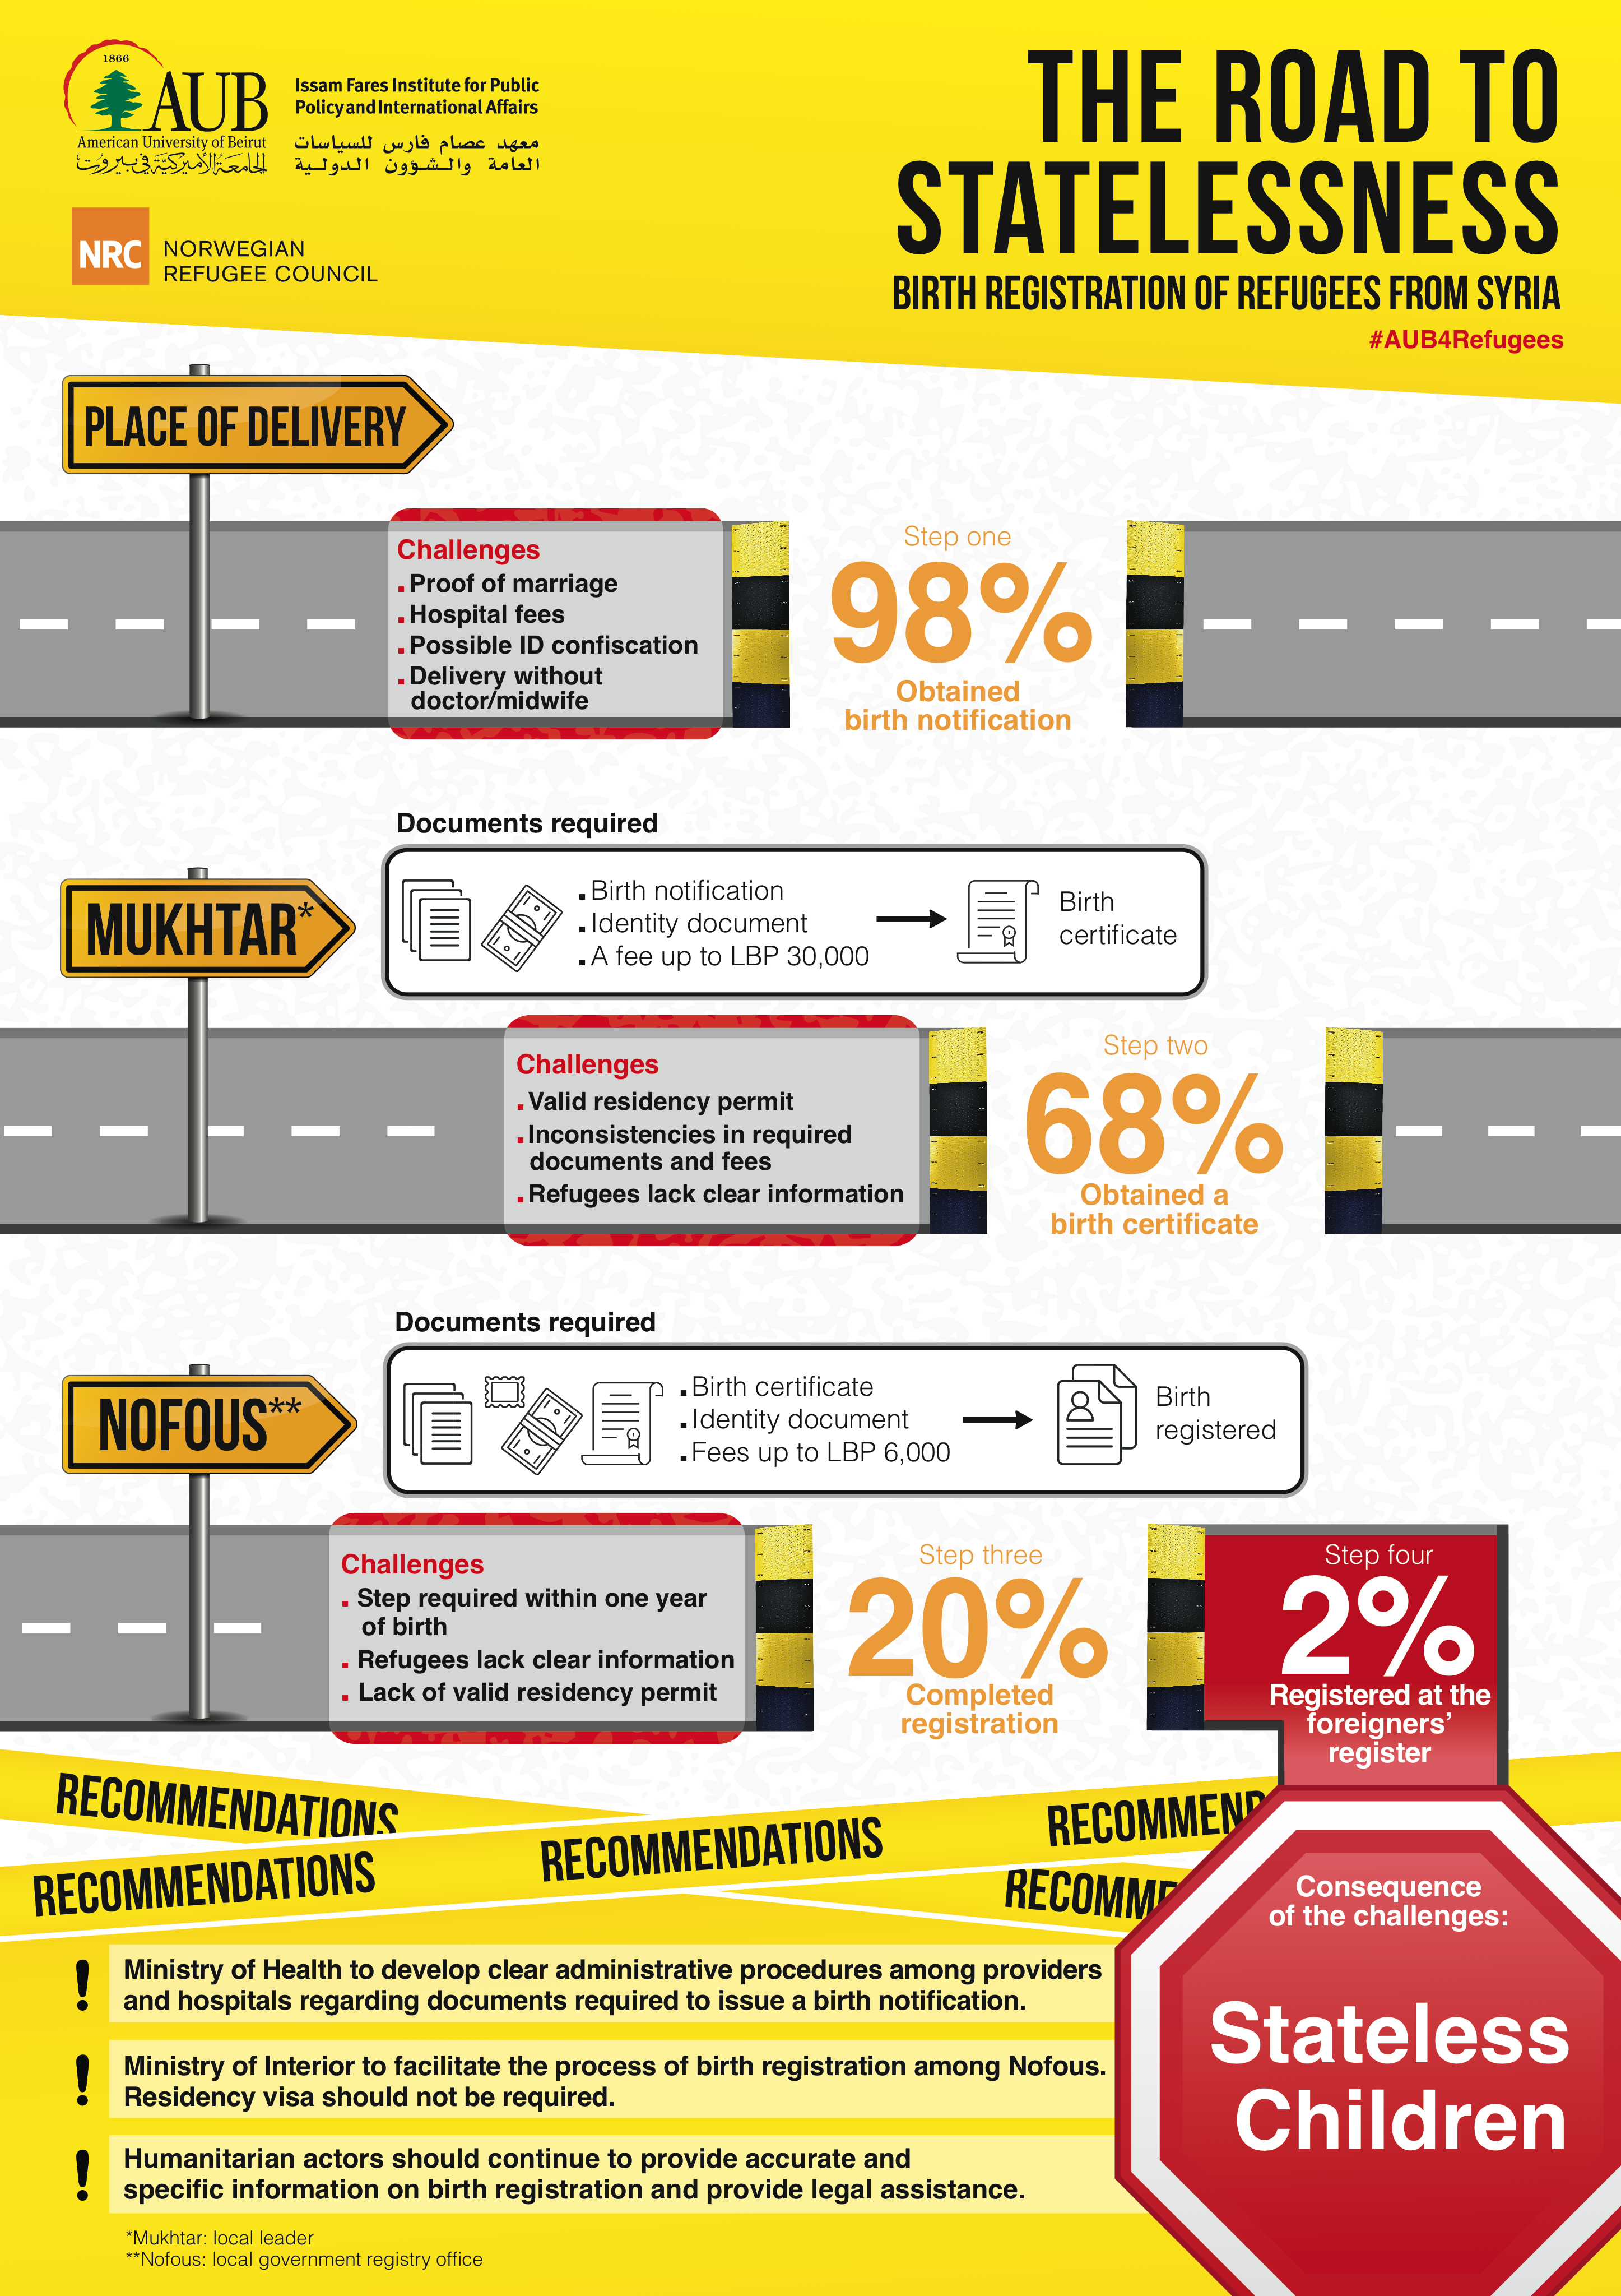

Slide 7

Challenges to Birth Registration for refugees from Syria
Lack of residency visa/legal stay in Lebanon
Lack of Documents required for birth registration (e.g. marriage certificate)
Lack of financial means, limited freedom of movement
Birth delivery from an uncertified midwife
Unregistered babies over one year old who were born in Lebanon
Babies born in Syria who have not been registered before coming to Lebanon
Inconsistent practices amongst mukhtars / nofous offices

Slide 8
NORWEGIAN
REFUGEE COUNCIL
For more information, contact:
Tina Gewis, NRC ICLA Specialist
tina.gewis@nrc.no
www.nrc.no

