Slide 1
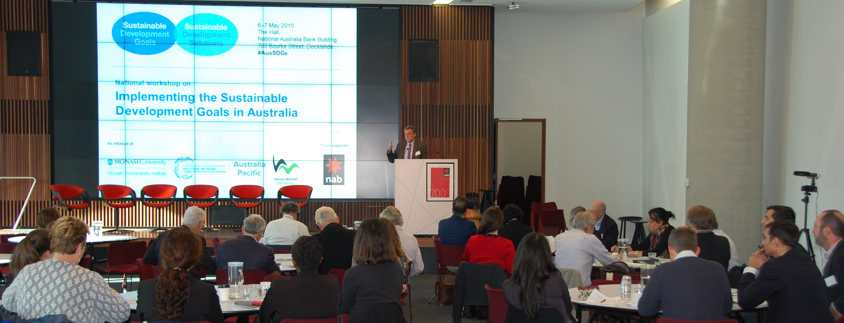
How to deal with interactions between the Sustainable Development Goals
David Griggs

Slide 2
Why are interactions important
UN Secretary-General described SDGs as “an indivisible whole”.
But everything is siloed - government departments, university faculties, international organisations
But if countries ignore the overlaps and simply start trying to tick off targets one by one, they risk perverse outcomes.
For example, using coal to improve energy access (goal 7) would accelerate climate change and acidify the oceans (undermining goals 13 and 14), as well as exacerbating other problems such as damage to health from air pollution (disrupting goal 3).

Slide 3
Integrating the SDGs Interlinkages, synergies and trade-offs

Slide 4
The reasons for “action incoherence”
or why interactions are often ignored or are not fully taken into account.
Everything is siloed
Government departments, company divisions, university faculties, international institutions are organised into discipline or sector based silos. It simplifies decision making and makes taking action easier.
Systems are set up to be competitive
Government departments and Un agencies compete for budget, businesses compete for market share, universities compete for research income and students, NGOs compete for philanthropic funding. In a competitive system it is difficult to form the partnerships necessary for managing interactions.
There is an overhead to acting coherently
There is an overhead in terms of time, effort and money to act coherently as people have to take the time to form partnerships and learn to understand an issue from other perspectives. This also takes effort and costs money for people to meet and work together.

Slide 5
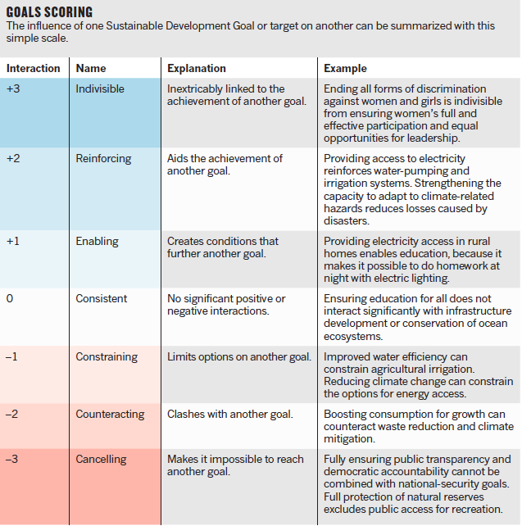
SDG interlinkages
Strength
Directionality
Level of uncertainty

Slide 7
SDG interlinkages
Other dependencies
Reversibility: e.g., Lack of climate action (goal 13) leads to loss of species (goal 15) is irreversible
Directionality: e.g., providing energy to people’s homes benefits education, but improving education does not directly provide energy is unidirectional
Strength: does an interaction with another goal have a large or small impact
Uncertainty: how certain or uncertain is the interaction

Slide 8
SDG interlinkages
Other dependencies cont’d
Governance: Sometimes negative interactions are just poor governance
Geography: Some actions have interlinkages in other places or countries
Time sensitivity: Some interactions play out in real time but others have time lags
Technology: Technology developments can go both ways, e.g., renewable energy technology vs the disposable culture

Slide 9
Quote:
Having been engaged in this process over the last months, one key insight for me is that the act of going through the process of assessing what the score should be (using the actual Nilsson, Griggs, Visbeck guidance) is where a lot of the real value is, not necessarily in the exact scores that are ultimately arrived at. The process forces one to look at the literature, think through the issues and potential context dependencies, and discuss ideas with others. It’s a vehicle for getting the conversation and brain juices flowing, and that’s a good thing. I’ve enjoyed it myself.
David McCollum, IIASA

Slide 10
Prioritising action
Different countries will have different national contexts and different priorities so it is OK to prioritise across and within the SDGs to reflect that national context
However:
It is not OK to prioritise on the basis of what is easy or achievable.
It is not OK to prioritise or just report on what will make you look good
It is not OK to ignore the implications of action on your priorities on other SDGs

Slide 11
What are the properties required of multi-stakeholder partnerships that are well suited to addressing the SDGs
They must be driven by a higher common purpose, e.g., the SDGs, rather than sector based, short term drivers.
They must be flexible and participatory, involving all the relevant stakeholders that have expertise to bring to bear, which will bring new actors into the system.
They need to be more flexible than in the past, adapting quickly to changing needs and new information.
They must be able to work effectively across pillars or silos.
They must be open and transparent so progress towards achieving the SDGs can be monitored and evaluated.
They must provide a place for safe discussions and piloting solutions.
They must be able to communicate effectively the benefits of meeting the SDGs and to move beyond empire building to partnerships for impact.

Slide 12
So how do we get the multi-stakeholder partnerships that we need to achieve the SDGs?
There needs to be a clear demonstration of the value proposition of a coherent approach to delivering the SDGs.
Focused multi-stakeholder fora need to be established at national and other levels
Integrated national development plans and consequent integrated oversight ministries are one important approach at a national level.
Helping institutions re-frame their goals (e.g. mapping their place in the SDGs) is important.
Mechanisms for popularising, tracking and reporting on the SDGs need to be developed with good examples of success.
Need to be realistic about and address power relations, for example the power of multi-national companies, and develop incentives for some players to give up their power.

Slide 13
Implications for institutions and governance
The SDGs represent an important institutional innovation: a shift away from a focus on rules and “inter-national” rule-making towards a focus on goals. They reflect a theory of societal steering, or what we commonly think of as governance, that differs sharply from mainstream regulatory systems
Rule-making focuses on behavioral prescriptions (prohibitions and requirements) with a heavy emphasis on compliance mechanisms whereas goal-setting aims to concentrate human and material resources in a campaign to achieve specific objectives within a set period of time.
“Governance through goals,” requires engaging a broad set of stakeholders, beyond nation states and including business, civil society and academia in identifying issues, setting priorities, and delivering change
A public commitment by these stakeholders acts as the main incentive to deliver against the goals: “I’ve said I will do it, so I will”.
Institutions to implement the SDGs need to reflect this by involving stakeholders at a much more fundamental way

Slide 14
Operationalising interlinakges – the role of UN agencies
Understanding the commonalities and the differences across the region to understand what needs to be tackled at a national level and what can more effectively be tackled at a regional level
Promote the SDGs, and their implementation as an integrated approach to humanitarian and developmental challenges in the region
Provide regional co-ordination and expertise to facilitate regional approaches to SDG implementation
Provision of regional case studies into the Global Sustainable Development Review (GSDR) and other international processes
Conduct monitoring, follow-up and review on SDG implementation at a regional level

Slide 15
Challenges for UN agencies – what could they do better?
Improved co-ordination within the UN system so that the SDGs do not get siloed across the UN system, e.g., UN Water
Better involvement of stakeholders such as the private sector, civil society, academia and government
Reform of UN governance systems to better reflect the needs of the SDG as a goal based approach as opposed to a rule based approach.
Articulate that transformational change is required and what that means in practical terms
Engender public support for the SDGs

Slide 16
Summary
You must take into account the interlinkages when taking action on the SDGs
You must take into account the interlinkages when taking action on the SDGs!
You must take into account the interlinkages when taking action on the SDGs!

