Slide 1

AUB University Libraries Supports SDGs
Fatme Charafeddine
Associate University Librarian for Research and academic collaboration services – AUB University Libraries

Slide 2

What are the Sustainable Development Goals?
The 17 SDGs are at the heart of the UN 2030 Agenda for Sustainable Development, 2015.
SDGs supersedes the Millennium Development Goals (MDGs).
While the MDGs only applied to developing countries, the SDGs apply to all UN member states, are more ambitious and holistic.

Slide 3
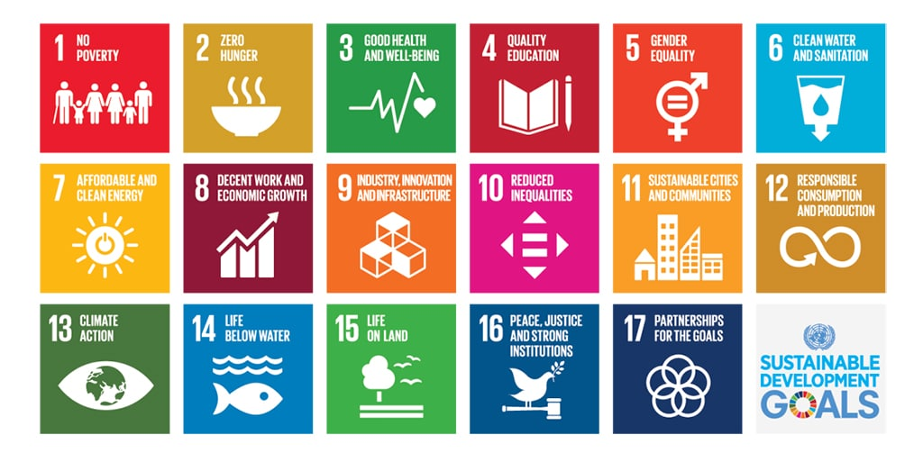
Aims of the 17 SDGs - 169 targets
Ending poverty, improve health and education, reduce inequality, and promote economic growth, all while tackling climate change and working to rescue and preserve the earth’s natural life.

Slide 4

Any Role for libraries?

Slide 5
SDGs and Libraries
Libraries traditional functions naturally contributes to improved outcomes across the (SDGs)
  Society is transformed through the power of knowledge and education.
  The collections and services of libraries contribute to scientific research and innovation.
  Libraries provide safe and inclusive spaces, equitable access to information and they protect readers’ freedom and privacy.
  Library associations are dedicated to advocate equal rights to information and learning.
  IFLA is championing the efforts to help libraries contribute to the SDGs.

Slide 6
If there are already national indicators, check if they reflect the work of libraries.
Official Commitments and Indicators
Lebanon
AUB
Lebanon ratified the UN 2030 Agenda.
Lebanese government put a National Strategy for SDGs.
Olayan School of Business is hosting SDGs Council which work closely with the Global Compact Network Lebanon.
FAFS leadership, formally joined (April 1, 2019) the Sustainable Development Solutions Network (SDSN).

Slide 7
AUB Libraries
Founded in 1882 , rich, historical and up-to-date
  Nami Jafet Memorial Library as the main library
  Engineering and Architecture Library
  Saab Memorial Medical Library
  Science and Agriculture Library

Slide 8








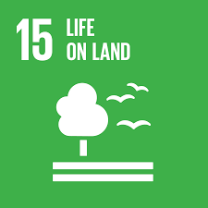
S
Academic Research for SDGs
The UL supports research and researchers. They subscribe to more than 250 databases which provide access to scholarly research and latest finding on water resources, energy usage, biodiversity, nature conservation, health, education, social and economic conditions, public policies and development strategies.

Slide 9


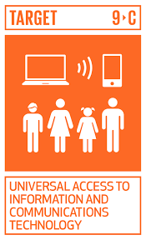
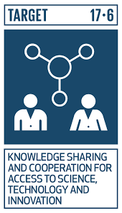
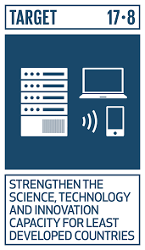

Innovation
The UL collections and staff support research and projects undertaken by the several initiatives and programs at AUB working on innovation, technology transfer, renewable energy and enhancing local economy.

Slide 10
UL SDGs FOCUS
Access to Information SDG 16.10 | Quality Education SDG 4.4 | Cultural Heritage SDG 11 | Reduce and Re-use SDG 12.5 | Effective Partnerships SDG 17.17
Ensure public access to information and protect fundamental freedoms | Substantially increase the number of youth and adults who have relevant skills, for employment, decent jobs and entrepreneurship | Strengthen efforts to protect and safeguard the world’s cultural and natural heritage | Substantially reduce waste generation through prevention, reduction, recycling and reuse | Encourage and promote effective partnerships, building on the experience and resourcing strategies of partnerships
Notes:
We chose, as I you’ve probably noticed, the Sustainable Development Goals.
Glòria has set out why these were so special. Unlike their predecessors, and indeed unlike any other globally agreed document, they offered a framework to explain the work of libraries.
All the dimensions of our work, all the ways in which our institutions improve lives.

Slide 11
SDG 16.10 Access to Information
    Access to a wide range of information 450.000 book, more than one million e-books, 250 databases, more than 144.000 e-journals.
    Online access to full-text from off-campus.
    Primary sources and special collections
    DDS/ ILL, New titles
    Visitors, 200 international researchers a year

Slide 12
SDG 16.10 Open Access to Information
Institutional Repository student theses (10.000), out of copy right faculty publications.
Digital Initiatives to digitize out of copyright historical and special collections, millions of pages already done.
Organize, and describe materials using standard metadata for better retrieval, preservation and compatibility with the semantic web.
Online exhibits featuring special collections or research theme.
Facilitating OA publishing between faculty members and publishers.

Slide 13
SDG 4 Quality Education
The UL support teaching and learning through a set of services provided by specialized librarians
  Library Instruction Program covering information literacy, digital literacy, thesis writing support, research data.
  Instructing users life long skills for information retrieval, use and attribution.
  Raising awareness about plagiarism and citation management
  Supporting research including doing systematic reviews

Slide 14
SDG 10 Reduce Inequalities
The UL is open for non-AUB walk-in users and researchers.
Improve the discoverability of local resources mostly in Arabic in order to close the gap with the quick and easy search for western resources.
Exhibits open to the public.
Collaboration with Next Step Program for adults with special needs.

Slide 15
SDG 11. 4 Protection of Cultural Heritage
Develop and manage a historical collection of books, journals and special collections
The conservation lab help in preserving library collections for sustainable access and use.
Digitization for preservation when applicable.

Slide 16
SDG 12 Reduce consumption and Re-use
The UL lend and share resources within its community and across borders.
Membership in library consortium, more resources for less spending and for ILL.
The Library is opting to acquire e-books instead of print for better access and sharing, storing and preservation.

Slide 17
SDG 17.7 Effective Partnerships
The UL partner with other University Libraries locally and Internationally.
  Consortium LALC, LIDS, AMICAL,
  Member of LLA and IFLA
Partnership with selected libraries and entities to work on special projects, Google Arts and Culture, NYU, Hathitrust, OACIS.
Internships for university students.
Community partnerships, book exchange, exhibits, book signing.
Any potential for partnerships among ESCWA region?

Slide 18
Role for Libraries in ESCWA
Network of research librarians in different subjects
Committee to discuss common technical challenges in connection to language automation and web services
A forum to information about open access collection
Start somewhere …

Slide 19


