Slide 1

Republic of Tunisia
Presidency of Government
SDG 16 in Tunisia
Amman, 12-13 December 2019
Notes:
1

Slide 2
National context on SDG 16
The different phases of the pilot initiative
SDG 16: The way forward
SDG16+

Slide 3
National context on SDG 16
A pilot initiative with the support of the UNDP, aimed to enhance the readiness of participating countries to integrate such a goal and related targets into national planning processes
The aftermath of the revolution and the aspirations for strengthening the governance of public affairs and ensuring sound grounds for the « Rule of Law » (the adoption of a new Constitution in January 2014)
Tunisia as one of the main advocates for the inclusion of Governance and Human rights in the new post-2015 development agenda
The initiative builds on the achievements of the MDGs

Slide 4

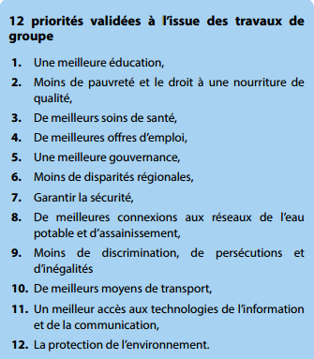
National Context on SDG16
Governance as one of the main priorities identified during the national consultations on the « Tunisia we want » held in 2014
4

Slide 5
National context on SDG 16
The different phases of the pilot initiative
SDG 16: The way forward

Slide 6
Phase 1: Contextualizing SDG16
The Presidency of Government (Services in charge of Governance) is the lead of this initiative
A participatory process with involvement of key stakeholders: Ministries, civil society organisations, UN agencies, universities,…
Contextualization of Goal 16 taking into account the national priorities and principles enshrined in the 2014 Constitution

Slide 7
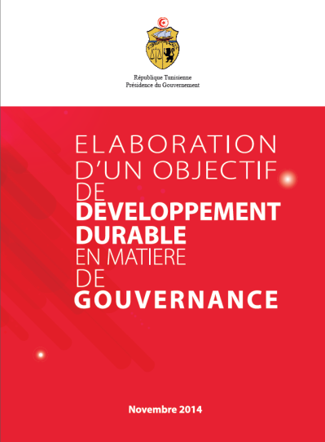
Phase 1: Contextualizing SDG16
1 Goal, 9 targets and 89 indicators
An emphasis on the promotion and protection of human rights
National Goal
« Consolidate a State which is the garantor of rights and fundamental freedoms, enhances efficiency, integrity, transparency and accountability of institutions at all levels in an enlighted, vigilant, inclusive and participatory society »
7

Slide 8
Phase 1: Contextualizing SDG16
9 Targets
Target 1: Promoting the Rule of Law and ensure equal and easy access to justice
Target 2: Preventing and fighting against terrorism, money laundering and all forms of cross-border crimes, especially human trafficking and cyber-criminality.
Target 3: Reduce corruption under all its forms
Target 4: Developing performing, innovative, accountable and transparent institutions, at all levels
Target 5: Ensuring inclusive participation during the development, monitoring, and evaluation of the public policies, at all levels
Target 6: Extend the effective representation and strengthen the responsible participation of Tunisia in the global governance institutions, managed equitably
Target 7: Ensuring efficient access to public information
Target 8: Ensuring the fundamental rights and freedoms of citizens (in accordance with national laws and ratified international agreements)
Target 9: Developing a socio-political environment conducive to sustainable democracy by ensuring the citizen awakening and engagement
8

Slide 9
Phase 1: Contextualizing SDG16
3 interconnected pillars
SOCIETY
Awake, vigilant, solidary and participatory
INSTITUTIONS
efficient, upright, transparent accountable
RULE OF LAW
State guarantor of fundamental rights and freedoms
9

Slide 10
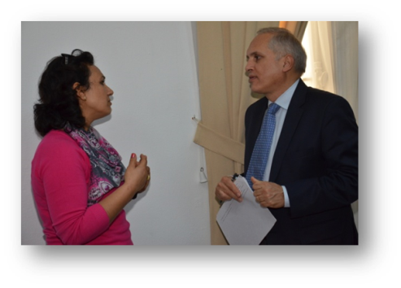
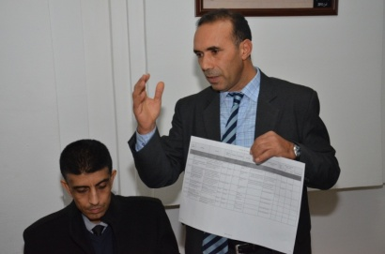
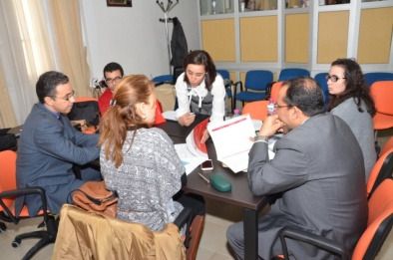
Phase 2: Prioritization and rationalization of indicators (2016)
Objectives
Reducing the large number of indicators chosen (89) according to their relevance, feasibility to be measured and monitored, and their alignment with the global indicators
Methodology
Participatory process
Building on the results of phase 1 and the global indicators adopted in 2016
Enlarging and strengthening partnership to others namely the National statistics institute, the Ministry of investment, development and international cooperation, Parliament
Results
  Number of indicators reduced to 34
10

Slide 11
Phase 3: Measuring SDG16
Elaboration of the Tunisia SDG16 Baseline study
4 main sections:
  Section 1: Introduction explaining the objectives, methodology and process of elaboration
  Section 2: Analysis of the situation of the goal following a participatory self-assessment conducted by a technical working group with representatives from Government and civil society
  Section 3: Analysis of the means of implementation, namely the national policies and strategies in place contributing to the achievement of the different targets
  Section 4: Preliminary analysis of the linkage of the Tunisian SDG16 to other SDGs in line with the SDG16+
6

Slide 12
Key findings
4 areas are fundamental to succeed the process
1
Strong national ownership and leadership translated into national strategies
Active coalitions, engaged stakeholders and knowledge exchange
2
Strengthening national capacities on producing, analysing statistical information
3
Availability of resources
4
6

Slide 13
National context on SDG 16
The different phases of the pilot initiative
SDG 16: Next steps

Slide 14
Next steps…
Intensifying mainstreaming targets and indicators into national and sub-national planning processes
Further understanding the connections between SDG16 and the rest of the 2030 Agenda
Focus on implementation of the SDG through an integrated approach
the first progress report included in the National Voluntary Report was presented in the 2019 High Level Political Forum and will prepare the NVR for 2021
Build on the different initiatives « Global alliance for reporting progress on promoting peaceful, just and inclusive societies », OGP,…
Launch of a new SDG16+ program with UNDP supported by the Government of the Netherlands aimed at supporting the achievement of the goals through integrated interventions both at the national and sub-national levels
14

Slide 15
Why SDG 16+
In its ResolutionsA/RES/70/262 et S/RES/2282, the General Assembly and the Security Council had addressed “Sustaining Peace” by “emphasizing the importance of a comprehensive approach, particularly through the prevention of conflict and addressing its root causes, strengthening the rule of law at the international and national levels, and promoting sustained and sustainable economic growth, poverty eradication, social development, sustainable development, national reconciliation and unity including through inclusive dialogue and mediation, access to justice and transitional justice, accountability, good governance, democracy, accountable institutions, gender equality and respect for, and protection of, human rights and fundamental freedom”.
Sustaining peace and Goal 16 are not only valuable and important aspirations in their own right, they are also important enablers for the three pillars of the United Nations (Peace, Development and Human Rights) and the 2030 sustainable development agenda.

Slide 16
The proposed program is articulated according to the following theory of change:
IF AT THE NATIONAL LEVEL the key political and administrative institutions foreseen in the 2014 Constitution are set up and their capacities strengthened to be able to conduct their missions and attributions inclusively and transparently and ensure the protection and promotion of human rights,
And the main national reforms and processes aimed at promoting democratic governance, consolidating the rule of law and civic engagement at all levels are defined and implemented,
IF AT THE LOCAL LEVEL regional and municipal governments see their capacities strengthened to adopt mechanisms of participatory democracy and engage in inclusive development planning that promotes sustainable development,
And efforts aimed at promoting access to justice, community security, preventing violent extremism, are strengthened with a particular focus on empowering youth, women and vulnerable groups,
IF throughout the program particular attention is provided to: ensuring an integrated approach that maximizes the impact of the interventions; focusing on endogenous resilience factors at the community level; supporting the implementation of innovative solutions at the national and local levels; monitoring and evaluating through strengthened data and statistical systems; and capturing, managing and disseminating the knowledge generated for future scale-up,

Slide 17
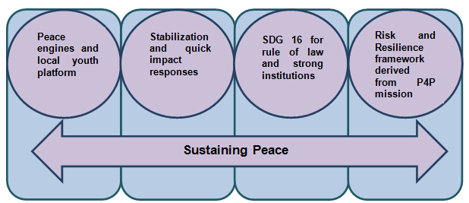
The programme will be part of a platform on Sustaining Peace the UN in Tunisia currently being defined that will be composed of four programmatic pillars, which will be closely interconnected:
Peace engines (Support resilience capacities) and youth local platforms
Stabilization and quick impact responses to communities
Risk and Resilience framework derived from the joint World Bank/UN Pathways for Peace initiative
SDG16 for peace, rule of law and strong institutions.

Slide 18
Sustainable development in Tunisia is enabled by a peaceful, just and inclusive society
Impact
THE KEY NATIONAL INSTITUTIONS AND PROCESSES AIMED AT PROMOTING DEMOCRATIC GOVERNANCE, CONSOLIDATING THE RULE OF LAW AND FOSTERING CITIZENSHIP ARE OPERATIONALISED
COMMUNITIES, IN PARTICULAR YOUTH, WOMEN AND VULNERABLE GROUPS, BENEFIT FROM AND CONTRIBUTE TO EFFORTS AIMED AT PROMOTING LOCAL DEVELOPMENT, STRENGTHENING ACCESS TO JUSTICE AND SECURITY AND SOCIAL COHESION
Capacities of national and subnational institutions strengthened to identify effective solutions and demonstrate progress towards the achievement of SDG16
Outcomes
Approach based on:
  2030AgendaCore principles namely “leaving no-one behind”, interconnectedness of the SDGs and inclusiveness
Sustaining peace to ensure an inclusive and conflict sensitive approach focus on strengthening resilience factors and capacities - infrastructures for peace
Cumulative approach, to build on existing capacities and know-how developed through UNDP interventions since 2011
Integration of interventions: Breaking the silos between projects through a programmatic approach and geographic convergence
Participatory local development planning as a backbone for local interventions
Partnerships (State, Local governments, Civil Society, communities, UN Agencies and other IGO)
Innovation: Promote the identification of new approaches, provide a safe space for testing them, and support in scaling them.

Slide 19
Sustainable development in Tunisia is enabled by a peaceful, just and inclusive society
institutional capacity development (technical and logistical)
participatory and inclusive policy support and planning
support non-state actors (civil society and communities in particular youth and women)
direct support to definition and implementation of high impact innovative solutions at the national and local levels
knowledge development and management (south-south and triangular cooperation, dissemination of lessons learned, communication)
Ongoing governance work and other workstreams
Existing projects and programmes on parliamentary development, rule of law, public and social accountability, decentralisation and local development, social cohesion and PVE
Planned interventions linked to the SG initiative on sustaining peace
Problem statement/Development challenges
Fragility of the democratic transition due to the unfinished reform processes and institutional configuration foreseen in the 2014 Constitution and the despair felt by the population who is not benefitting from the achievements of the transition and suffers from a dire economic and social situation especially in the interior regions

Slide 20
The programme is closely linked to SDG16 by covering all three pillars of the goal, namely:
Build effective, accountable and inclusive institutions at all levels: the support to be provided to key institutions such as Parliament and the newly elected local governments in strengthening their transparency and their inclusiveness as well as the independent bodies directly involved in the promotion of good governance and the strengthening of public accountability (Institution on Good Governance and Anti-Corruption and the Institution on access to information)
Provide access to justice for all: At the national level, support will be pursued to the implementation of the national strategy on justice reform as well as to the new Supreme Judicial Council key to ensuring the independence of the judiciary. Support will also be provided to help set-up and strengthen a series of key Rule of Law and Human Rights bodies, namely the Constitutional Court, the Human Rights Institution and the National Institution on Torture Prevention.
Promote peaceful and inclusive societies for sustainable development: Within the framework of the Sustaining Peace platform currently being defined in Tunisia, the programme will support a series of resilience factors or infrastructures for peace that UNDP has been helping set-up since 2011. These include:
Preventing violent extremism
Civil society and the Tunisian Organisation on Social Cohesion
Community policing and local security committees
Youth empowerment and youth centres
Gender equality and violence against women

Slide 21
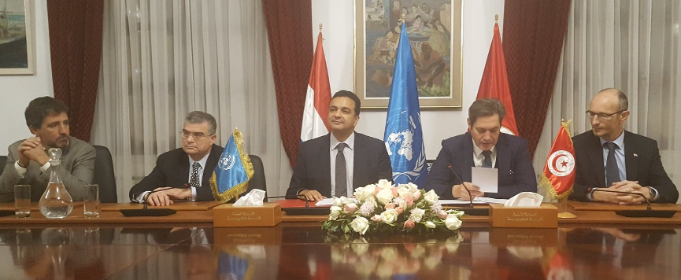
Project title: Sustaining peace through the promotion of a peaceful, just and inclusive society in Tunisia
Signature of the PRODOC in December 14th. 2018

Slide 22
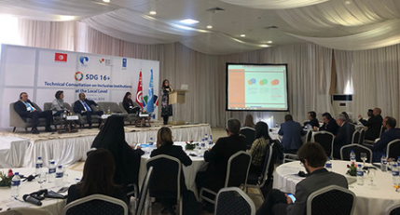
THE TECHNICAL CONSULTATION ON INCLUSIVE INSTITUTIONS AT THE LOCAL LEVEL, March 2019 Tunisia

Slide 23
Thank you for your attention
Ines Kharrat Driss : ines.kharrat@pm.gov.tn

