Slide 1
Praia City Group on Governance Statistics
Handbook on Governance Statistics
Celso Soares
Deputy Chairman of Statistics Cabo Verde and of Praia City Group

Slide 2
Agenda
Praia Group: Mandate and objectives
Handbook on Governance Statistics
Recommended SDGs 16 indicators

Slide 3
Praia Group: Mandate and objectives

Slide 4
Mandate and objectives (1/2)
Mandate:
The Praia Group has as its mandate to “contribute to establishing international standards and methods for the compilation of statistics on the major dimensions of governance”.
The Group has been charged to develop “a Handbook on Governance Statistics for National Statistical Offices, which will cover the conceptualization, measurement methodology and dissemination of governance statistics”.

Slide 5
Mandate and objectives (2/2)
Objectives:
To serve as an international forum for sharing and developing expertise in governance statistics.
To review, propose and promote the definition and harmonization of governance statistics indicators, trough the development of manuals and methodological guidelines.
To contribute to development of the framework for measuring and monitoring peace and governance goals (SDG 16).
Notes:
Os objetivos do Grupo Praia são:

Slide 6
Handbook on Governance Statistics

Slide 7
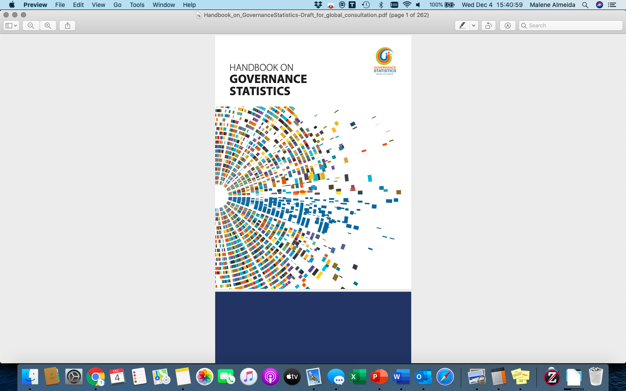
Handbook on Governance Statistics
The Handbook on Governance Statistics takes stock of existing practices in governance data collection and proposes guidelines for the improved production and compilation of governance, peace, security, human rights and rule of law indicators.
The Handbook outlines existing standards, emerging good practices and provides guidance on how to measure many aspects of SDG 16 based on 8 dimensions: Non discrimination and equality, Participation, Openness, Access to and quality of justice, Responsiveness, Government effectiveness, Absence of corruption, Trust in institutions, and Safety and security.
Notes:
Para a elaboração do manual em estatísticas de governança (handbook) foi apresentado em 2017 e atualizado em 2018 o framework que serve de base para manual. O manual assenta em 8 dimensões de Governança a saber .....
Aqui também podem os líderes de cada grupo de trabalho que preparam a elaboração do manual

Slide 8
Handbook on Governance Statistics
Definitions of the 8 dimensions of Governance Statistics
Focuses on any distinction, exclusion, restriction or preference or other differential treatment based on grounds such as colour, sex, language, religion, national or social origin, disability or other status, that has the intention or effect of nullifying or impairing human rights and fundamental freedoms.
Non discrimination and equality
Participation
Focuses on the ways in which individuals take part in the conduct of political and public affairs, including by registering to vote, voting and standing as a candidate in elections; being members of legislative, executive and judicial bodies at all levels of government; accessing positions in the public service; and engaging, individually or as members of political parties and other non-governmental organizations, in political activities.
Openness
Focuses on the extent to which public institutions provide access to information and are transparent in their decision- and policy-making processes. More specifically, the dimension covers access to information, open government provisions, freedom of expression and media pluralism.
Access to and quality of justice
Focuses on the ability of people to defend and enforce their rights and obtain just resolution of justiciable problems — if necessary, through impartial formal or informal institutions of justice and with appropriate legal support.
Responsiveness
Focuses on whether people have a say in what government does and whether they are satisfied with the government’s performance.
Absence of corruption
Focuses on the levels of intolerance to corruption; the levels and patterns of observable corrupt practices; and the State response to corruption.
Trust
Focuses on people’s trust in institutions as well as in other people, with a primary focus on the former, e.g. the parliament, the national government and the justice system.
Safety and security
Focuses on levels and patterns of crime, perceptions of safety, measurement of casualties directly provoked by armed operations, and the quality of law enforcement and criminal justice institutions.

Slide 9
Handbook on Governance Statistics
Link to download the Handbook on Governance Statistics:
http://ine.cv/praiagroup/handbook/Handbook_on_GovernanceStatistics-Draft_for_global_consultation.pdf
Notes:
Os objetivos do Grupo Praia são:

Slide 10
Recommended SDGs 16 indicators

Slide 11
Recommended SDGs 16 indicators
Non discrimination and equality
Participation
Openness
Access to and quality of justice
SDG 16.b.1 Proportion of population reporting having personally felt discriminated against or harassed in the previous 12 months on the basis of a ground of discrimination prohibited under international human rights law
  SDG 16.7.1 Proportions of positions in national and local institutions, including (a) the legislatures; (b) the public service; and (c) the judiciary, compared to national distributions, by sex, age, persons with disabilities and population groups
  SDG 16.7.2 Proportion of population who believe decision-making is inclusive and responsive, by sex, age, disability and population group *
  SDG 16.10.1 Number of verified cases of killing, kidnapping, enforced disappearance, arbitrary detention and torture of journalists, associated media personnel, trade unionists and human rights advocates in the previous 12 months
  SDG 16.10.2 Number of countries that adopt and implement constitutional, statutory and/or policy guarantees for public access to information
  SDG 16.3.1 Proportion of victims of violence in the previous 12 months who reported their victimization to competent authorities or other officially recognized conflict resolution mechanisms
  SDG 16.3.2 Unsentenced detainees as a proportion of overall prison population
Note: * Discussed also on Responsiveness chapter
Notes:
Mencionar que a dimensão TRUST não recomenda nenhum indicador relacionado com o ODS 16

Slide 12
Recommended SDGs 16 indicators
Responsiveness
Absence of corruption
Safety and security
SDG 16.6.2 Proportion of population satisfied with their last experience of public services
SDG 16.7.2 Proportion of population who believe decision-making is inclusive and responsive, by sex, age, disability and population group
  SDG 16.5.1 Proportion of persons who had at least one contact with a public official and who paid a bribe to a public official, or were asked for a bribe by those public officials, during the previous 12 months
  SDG 16.5.2 Proportion of businesses that had at least one contact with a public official and that paid a bribe to a public official, or were asked for a bribe by those public officials, during the previous 12 months
  SDG 16.1.1 Number of victims of intentional homicide per 100,000 population, by sex and age
  SDG 16.1.2 Conflict-related deaths per 100,000 population, by sex, age and cause
  SDG 16.1.3 Proportion of population subjected to (a) physical violence, (b) psychological violence and (c) sexual violence in the previous 12 months
SDG 16.1.4 Proportion of population that feel safe walking alone around the area they live
SDG 16.2.1 Proportion of children aged 1–17 years who experienced any physical punishment and/or psychological aggression by caregivers in the past month
SDG 16.2.2 Number of victims of human trafficking per 100,000 population, by sex, age and form of exploitation
SDG 16.2.3 Proportion of young women and men aged 18–29 years who experienced sexual violence by age 18
SDG 16.4.2 Proportion of seized, found or surrendered arms whose illicit origin or context has been traced or established by a competent authority in line with international instruments
SDG 16.7.1c Proportions of positions in national and local institutions in the judiciary, compared to national distributions, by sex, age, persons with disabilities and population groups*
Note: * Discussed also on Participation chapter

Slide 13
Recommended SDGs 16 indicators
Four of the SDGs 16 indicators are not covered on the Handbook, due to the fact that they did not fit naturally under any of the eight dimensions:
SDG 16.4.1 Total value of inward and outward illicit financial flows (in current United States dollars);
SDG 16.6.1 Primary government expenditures as a proportion of original approved budget, by sector (or by budget codes or similar);
SDG 16.8.1 Proportion of members and voting rights of developing countries in international organizations; and
SDG 16.9.1 Proportion of children under 5 years of age whose births have been registered with a civil authority, by age.
Notes:
Os objetivos do Grupo Praia são:

Slide 14
Thank You/Merci/Obrigado
group.praia@gmail.com
Rua da Caixa Económica, nº18 | Praia | Ilha de Santiago
www.ine.cv | facebook.com/ine.caboverde | twitter.com/INECV_Difusao

